Slide 1
Android Developer Fundamentals V2
User Interaction
Lesson 4

Slide 2
4.4 User navigation

Slide 3
Contents
Back navigation
Hierarchical navigation
Up navigation
Descendant navigation
Navigation drawer for descendant navigation
Lists and carousels for descendant navigation
Ancestral navigation
Lateral navigation

Slide 4


Two forms of navigation
Back (temporal) navigation
Provided by the device's Back button
Controlled by the Android system back stack
Ancestral (Up) navigation
Up button provided in app bar
Controlled by defining parent Activity for child Activity in the AndroidManifest.xml
Notes:
Up is left

Slide 5
Back Navigation

Slide 6
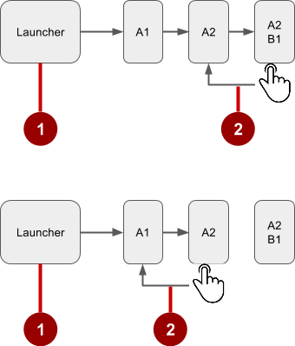
Navigation through history of screens
Historys starts from Launcher
User clicks the Back button to navigate to previous screens in reverse order

Slide 7
Changing Back button behavior
Android system manages the back stack and Back button
If in doubt, don't change
Only override, if necessary to satisfy user expectation
For example: In an embedded browser, trigger browser's default back behavior when user presses device Back button

Slide 8
Overriding onBackPressed()
@Override
public void onBackPressed() {
// Add the Back key handler here.
return;
}

Slide 9
Hierarchical Navigation

Slide 10
Hierarchical navigation patterns
Parent screen—Screen that enables navigation down to child screens, such as home screen and main Activity
Collection sibling—Screen enabling navigation to a collection of child screens, such as a list of headlines
Section sibling—Screen with content, such as a story

Slide 11
Example of a screen hierarchy
Parent
Children: collection siblings
Children: section siblings
Use Activity for parent screen
Use Activity or Fragment for children screens
1
News App
2
Top Stories
Tech News
Cooking
Headline
Headline
Headline
Headline
Headline
Headline
Headline
Headline
Headline
Headline
Headline
Headline
3
Story
Story
Story

Slide 12
Types of hierarchical navigation
Descendant navigation
Down from a parent screen to one of its children
From a list of headlines—to a story summary—to a story
Ancestral navigation
Up from a child or sibling screen to its parent
From a story summary back to the headlines
Lateral navigation
From one sibling to another sibling
Swiping between tabbed views

Slide 13
Descendant Navigation

Slide 14
Descendant navigation
Descendant navigation
Down from a parent screen to one of its children
From the main screen to a list of headlines to a story
News App
Top Stories
Tech News
Cooking
Headline
Headline
Headline
Headline
Headline
Headline
Headline
Headline
Headline
Headline
Headline
Headline
Story
Story
Story

Slide 15
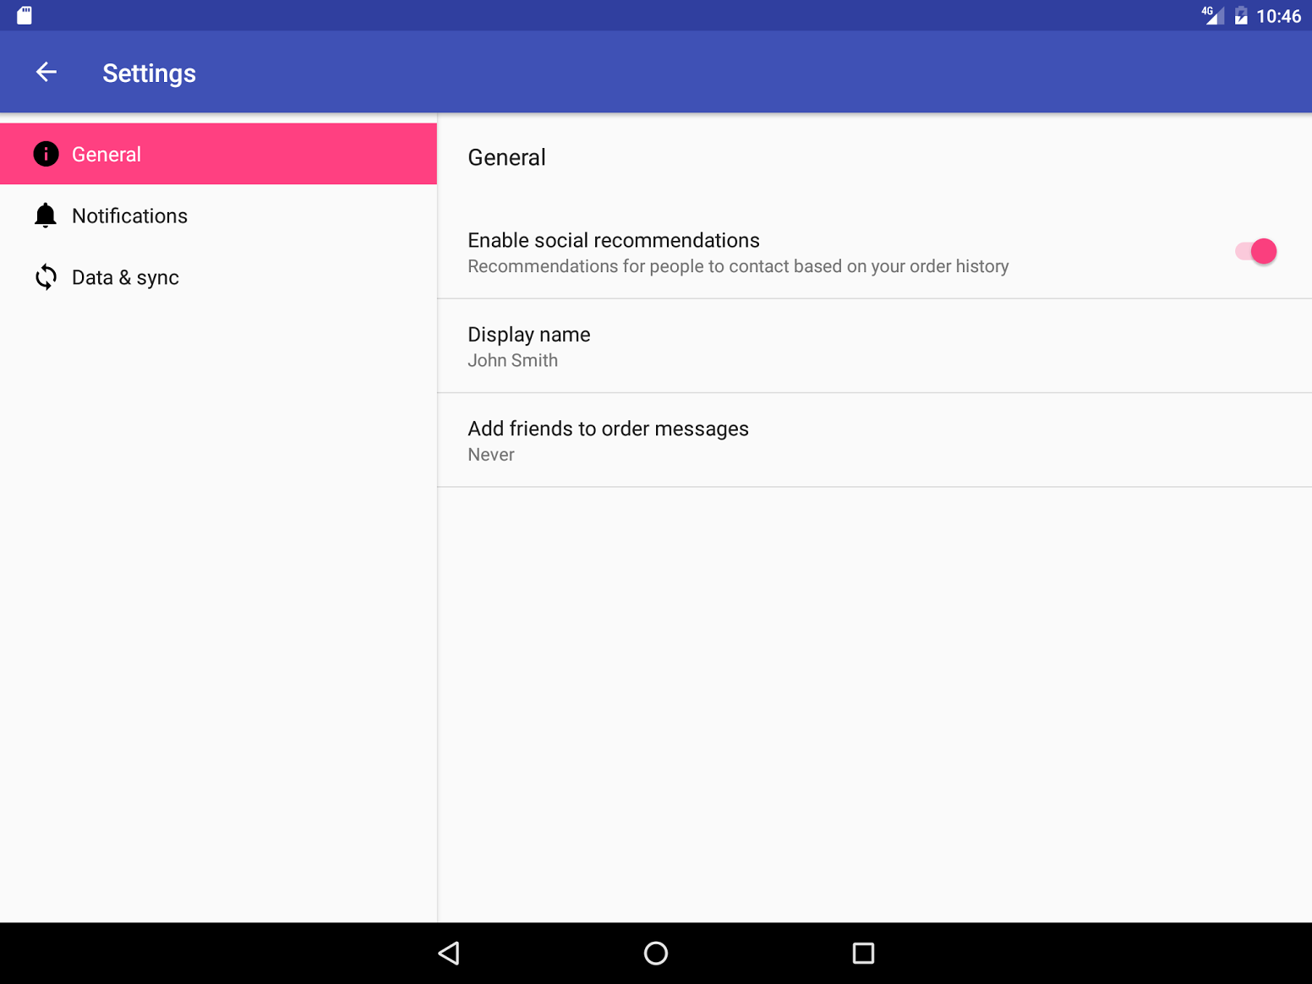
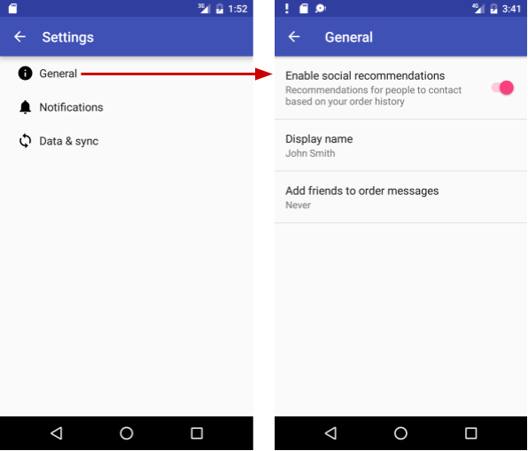
Master/detail flow
Side-by side on tablets
Multiple screens on phone

Slide 16
Controls for descendant navigation
Navigation drawer
Buttons, image buttons on main screen
Other clickable views with text and icons arranged in horizontal or vertical rows, or as a grid
List items on collection screens

Slide 17
Navigation Drawer

Slide 18
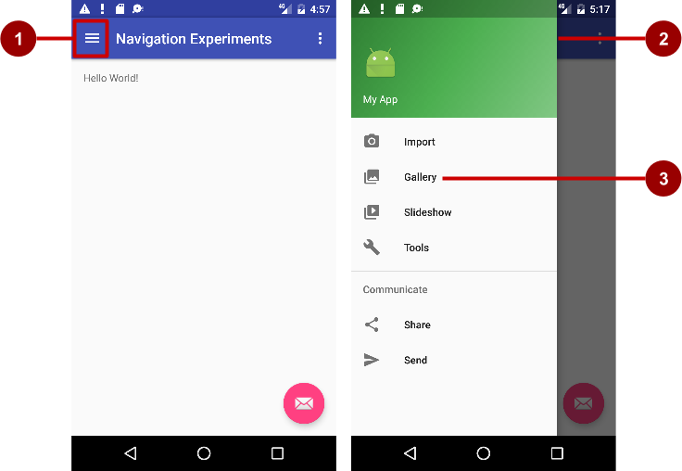
Navigation drawer
Descendant navigation
Icon in app bar
Header
Menu items

Slide 19
Layouts for for navigation drawer
Create layouts:
A navigation drawer as the Activity layout root ViewGroup
A navigation View for the drawer itself
An app bar layout that includes room for a navigation icon button
A content layout for the Activity that displays the navigation drawer
A layout for the navigation drawer header

Slide 20
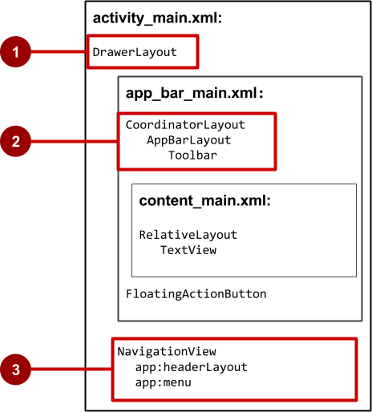
Navigation drawer Activity layout
DrawerLayout is root view
CoordinatorLayout contains app bar layout with a Toolbar
App content screen layout
NavigationView with layouts for header and selectable items
3
4

Slide 21
Steps to implement navigation drawer
Populate navigation drawer menu with item titles and icons
Set up navigation drawer and item listeners in the Activity code
Handle the navigation menu item selections

Slide 22
Steps to implement navigation drawer
Implement com.android.support:design:28.0.0
Implement com.android.support:support-core-utils:28.0.0
Use DrawerLayout for the MainActivity
setDisplayHomeAsUpEnable and setHomeButtonEnable for the support action bar
Create an ActionBarDrawerToggle object and link it with the DrawerLayout
onPostCreate(Bundle) -> sync the toggle state
onConfigurationChanged
onOptionsItemSelected

Slide 23
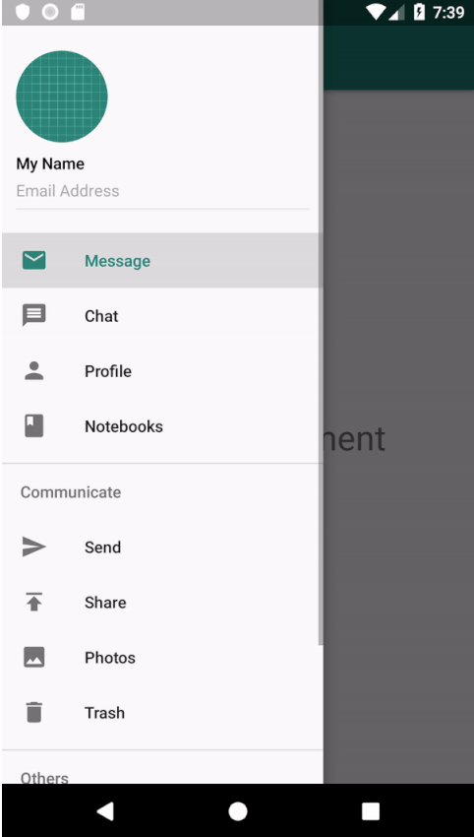
Steps to implement navigation drawer

Slide 24
Other descendant navigation patterns
Vertical list, such as RecyclerView
Vertical grid, such as GridView
Lateral navigation with a carousel
Multi-level menus, such as the options menu
Master/detail navigation flow

Slide 25
Ancestral Navigation

Slide 26
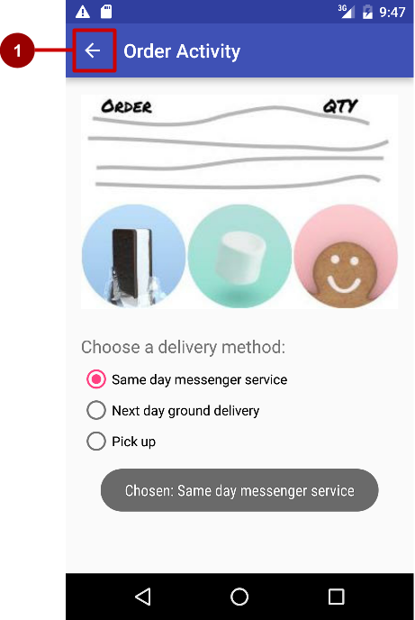
Ancestral navigation (Up button)
Enable user to go up from a section or child screen to the parent

Slide 27
Declare parent of child Activity—AndroidManifest
<activity android:name=".OrderActivity"
android:label="@string/title_activity_order"
android:parentActivityName="com.example.android.
optionsmenuorderactivity.MainActivity">
<meta-data
android:name="android.support.PARENT_ACTIVITY"
android:value=".MainActivity"/>
</activity>

Slide 28
Lateral Navigation

Slide 29
Tabs and swipes
Lateral navigation
Between siblings
From a list of stories to a list in a different tab
From story to story under the same tab
News App
Top Stories
Tech News
Cooking
Headline
Headline
Headline
Headline
Headline
Headline
Headline
Headline
Headline
Headline
Headline
Headline
Story
Story
Story

Slide 30
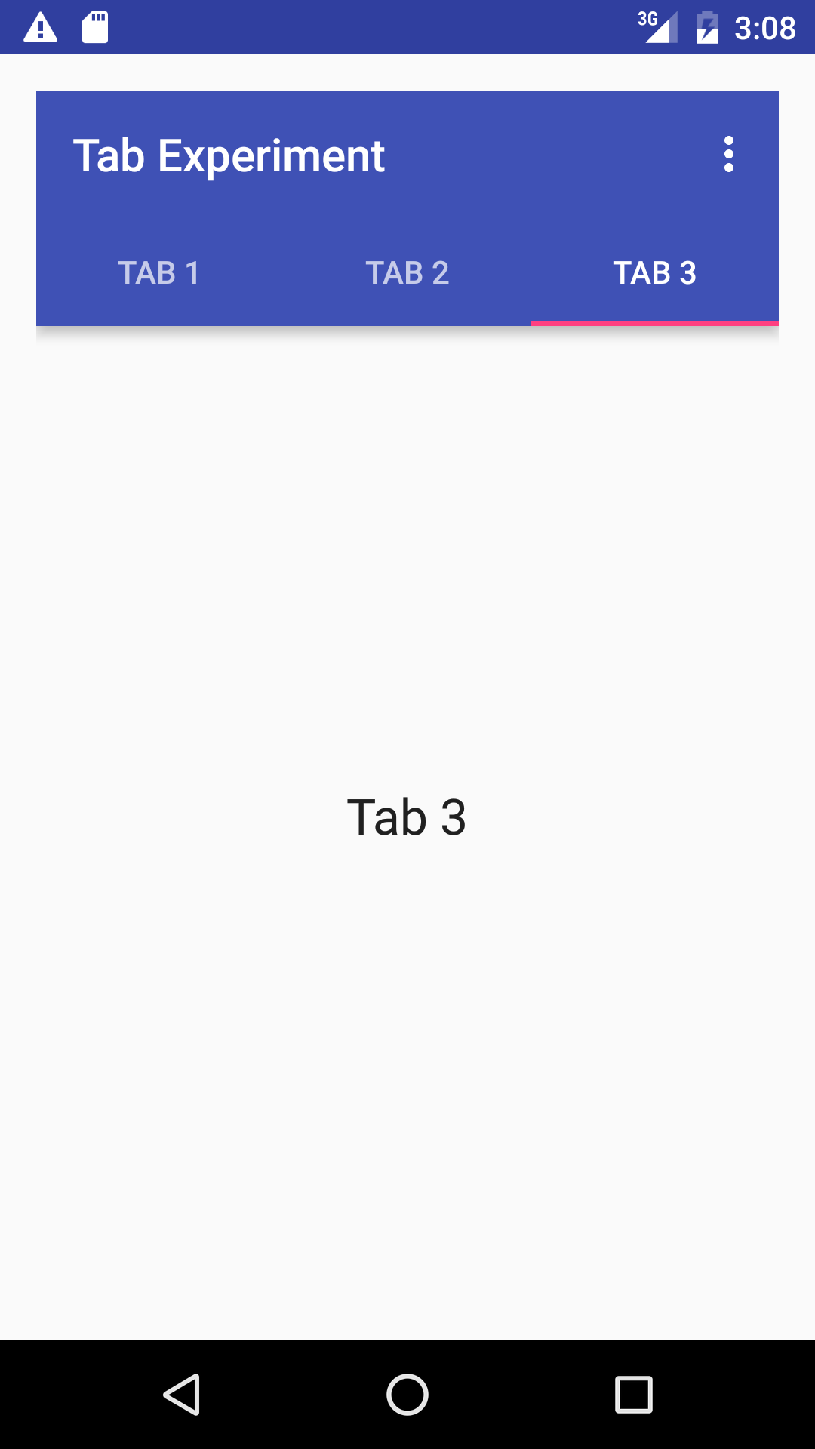
Benefits of using tabs and swipes
A single, initially-selected tab—users have access to content without further navigation
Navigate between related screens without visiting parent

Slide 31
Best practices with tabs
Lay out horizontally
Run along top of screen
Persistent across related screens
Switching should not be treated as history

Slide 32
Steps for implementing tabs
Define the tab layout using TabLayout
Implement a Fragment and its layout for each tab
Implement a PagerAdapter from FragmentPagerAdapter or FragmentStatePagerAdapter
Create an instance of the tab layout
Use PagerAdapter to manage screens (each screen is a Fragment)
Set a listener to determine which tab is tapped

Slide 33
Add tab layout below Toolbar
<android.support.design.widget.TabLayout
android:id="@+id/tab_layout"
android:layout_width="match_parent"
android:layout_height="wrap_content"
android:layout_below="@id/toolbar"
android:background="?attr/colorPrimary"
android:minHeight="?attr/actionBarSize"
android:theme="@style/ThemeOverlay.AppCompat.Dark.ActionBar"/>

Slide 34
Add view pager below TabLayout
<android.support.v4.view.ViewPager
android:id="@+id/pager"
android:layout_width="match_parent"
android:layout_height="fill_parent"
android:layout_below="@id/tab_layout" />

Slide 35
Create a tab layout in onCreate()
TabLayout tabLayout = findViewById(R.id.tab_layout);
tabLayout.addTab(tabLayout.newTab().setText("Tab 1"));
tabLayout.addTab(tabLayout.newTab().setText("Tab 2"));
tabLayout.addTab(tabLayout.newTab().setText("Tab 3"));
tabLayout.setTabGravity(TabLayout.GRAVITY_FILL);

Slide 36
Add the view pager in onCreate()
final ViewPager viewPager = findViewById(R.id.pager);
final PagerAdapter adapter = new PagerAdapter (
getSupportFragmentManager(), tabLayout.getTabCount());
viewPager.setAdapter(adapter);

Slide 37
Add the listener in onCreate()
viewPager.addOnPageChangeListener(
new TabLayout.TabLayoutOnPageChangeListener(tabLayout));
tabLayout.addOnTabSelectedListener(
new TabLayout.OnTabSelectedListener() {
@Override
public void onTabSelected(TabLayout.Tab tab) { viewPager.setCurrentItem(tab.getPosition());}
@Override
public void onTabUnselected(TabLayout.Tab tab) {}
@Override
public void onTabReselected(TabLayout.Tab tab) {} });

Slide 38
Learn more
Navigation Design guide d.android.com/design/patterns/navigation.html
Designing effective navigation d.android.com/training/design-navigation/index.html
Creating a Navigation Drawer d.android.com/training/implementing-navigation/nav-drawer.html
Creating swipe views with tabs d.android.com/training/implementing-navigation/lateral.html

Slide 39
What's Next?
Concept Chapter: 4.4 User navigation
Practical: 4.4 User navigation

Slide 40
END

